Slide 1

Linear Regression
Author: Rohit Mande
Founder and CEO, inttrvu.ai

Slide 2
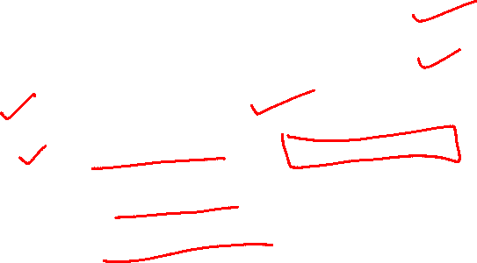
Index
What is Machine Learning?
What is Linear Regression?
Cost Function
Gradient Descent Optimisation
Multiple Linear Regression
Evaluation of Regression Models

Slide 3
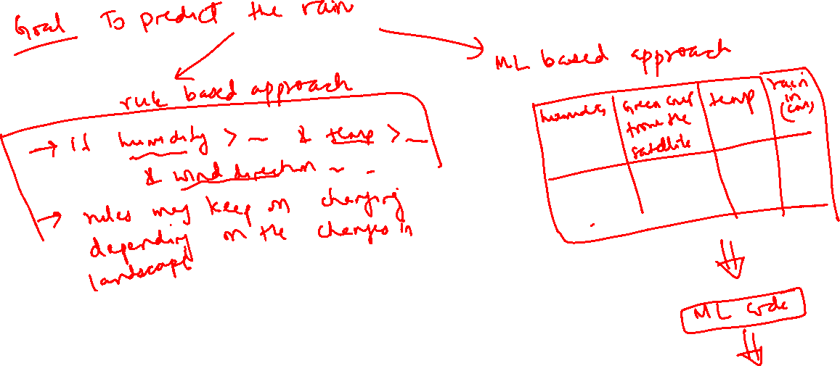
What is Machine Learning?

Slide 4
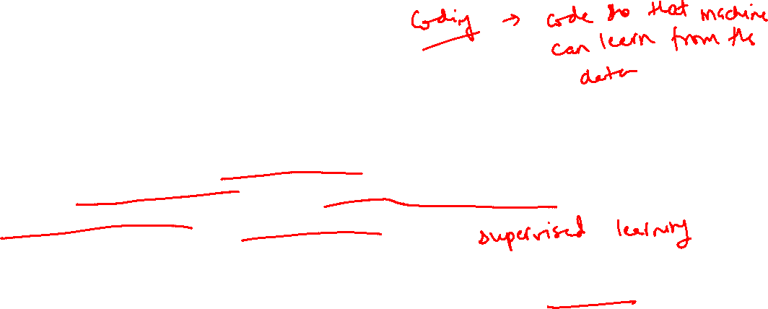
What is Machine Learning?
Machine Learning is the methodology/algorithm in which a machine (computer) learns based on the data without explicitly coding the rules
E.g., A baby learning the process of identification of a car
Machine learning systems get better at decision making with more data
E.g., Older baby start recognizing different types of cars

Slide 5
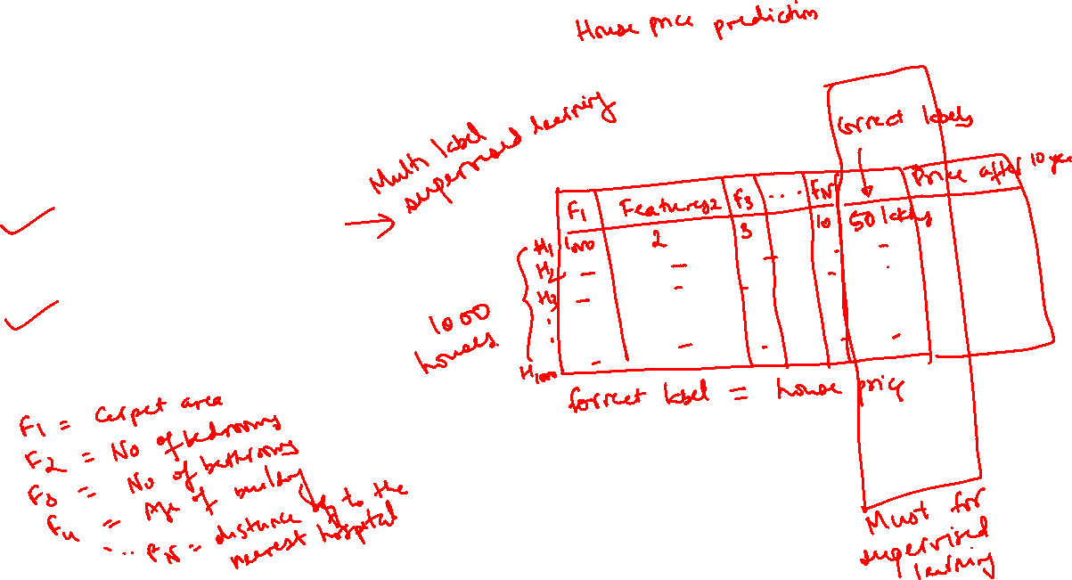
Types of Machine Learning
Supervised learning
Unsupervised learning

Slide 6
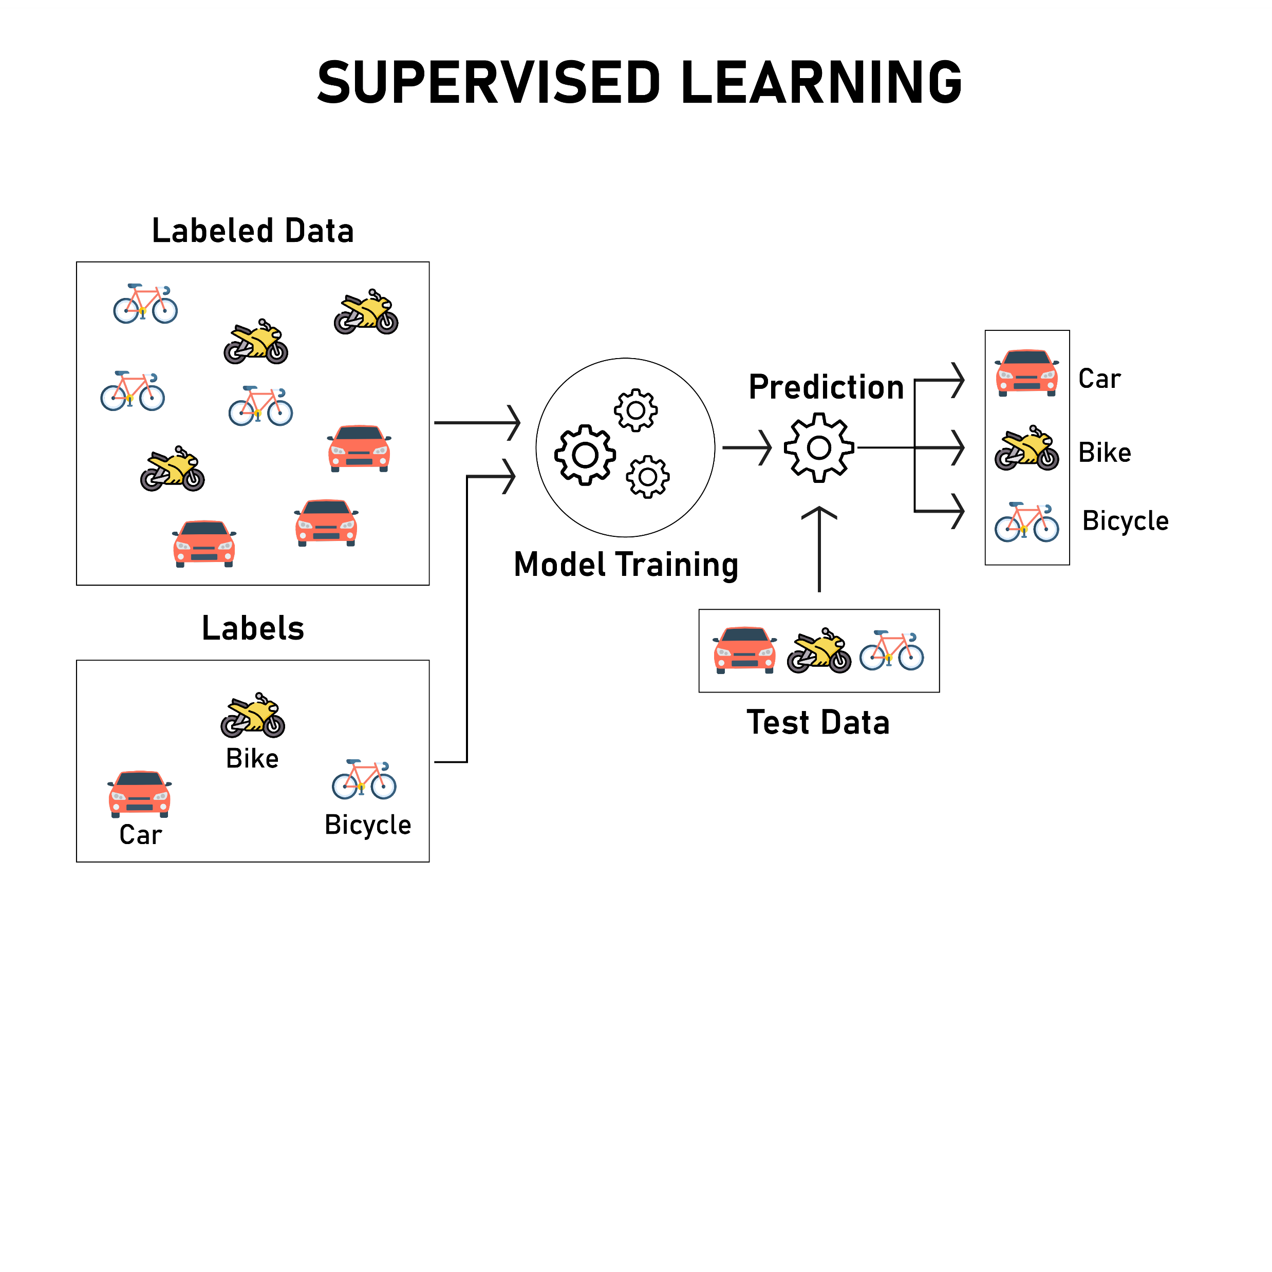
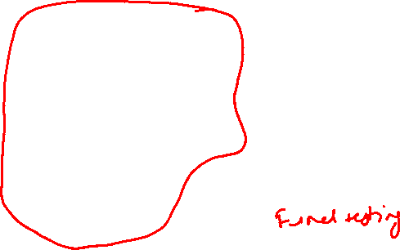
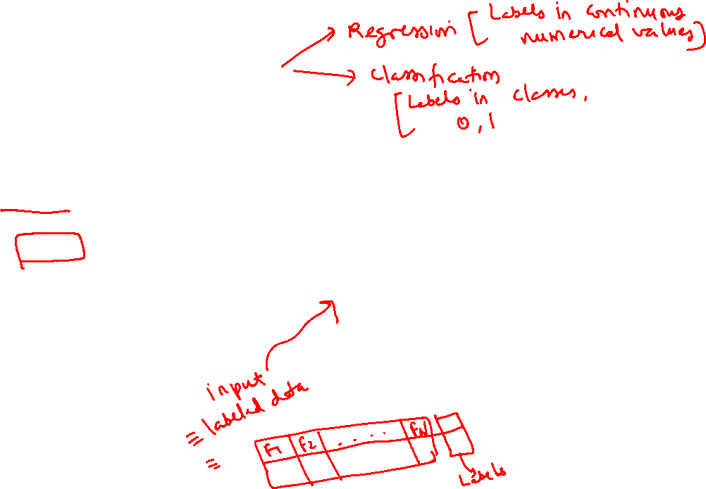
Supervised Learning
Supervised learning is the type of ML algorithms in which ML model learns based on examples of data and labels
E.g., Regression and classification models

Slide 7
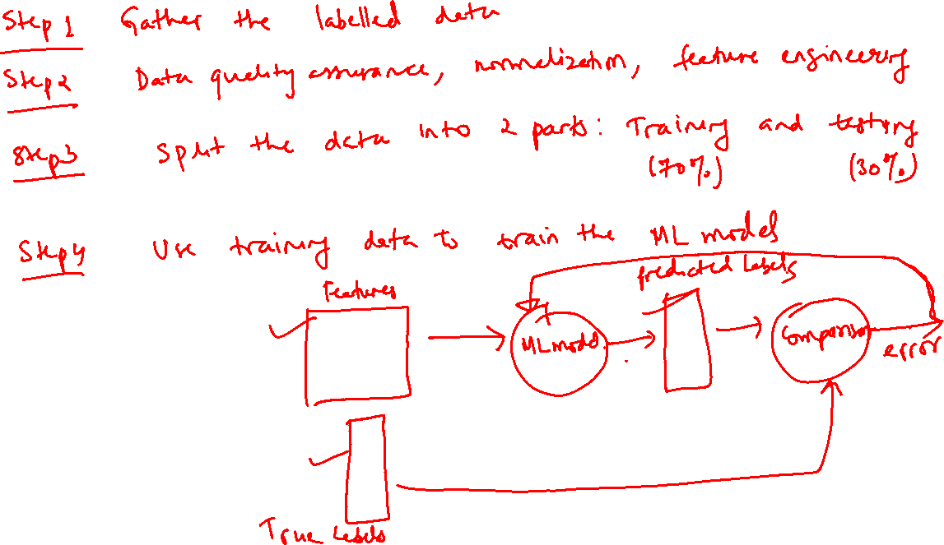

Slide 8
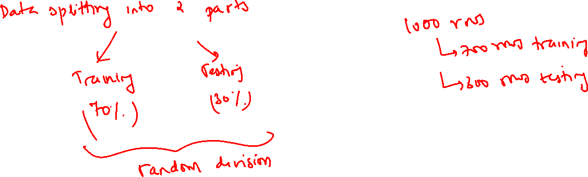

Slide 9
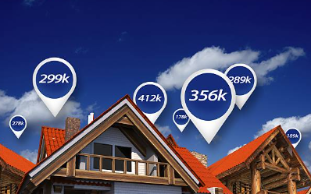

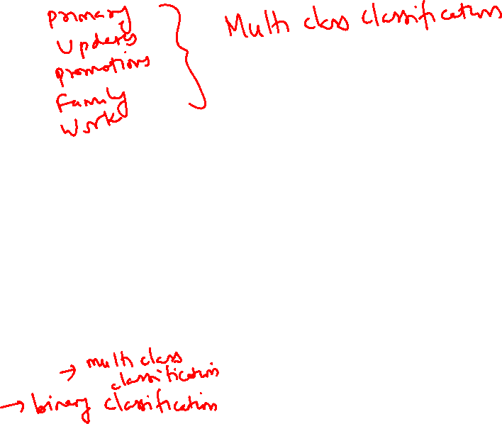
Supervised Learning
Regression:
Predict a continuous numerical value
E.g., House price prediction, insurance premium prediction
Classification:
Predict a category/class from predefined categories
E.g., Image object classification ( human/car/bike),
Email spam detection (spam/not a spam)

Slide 10
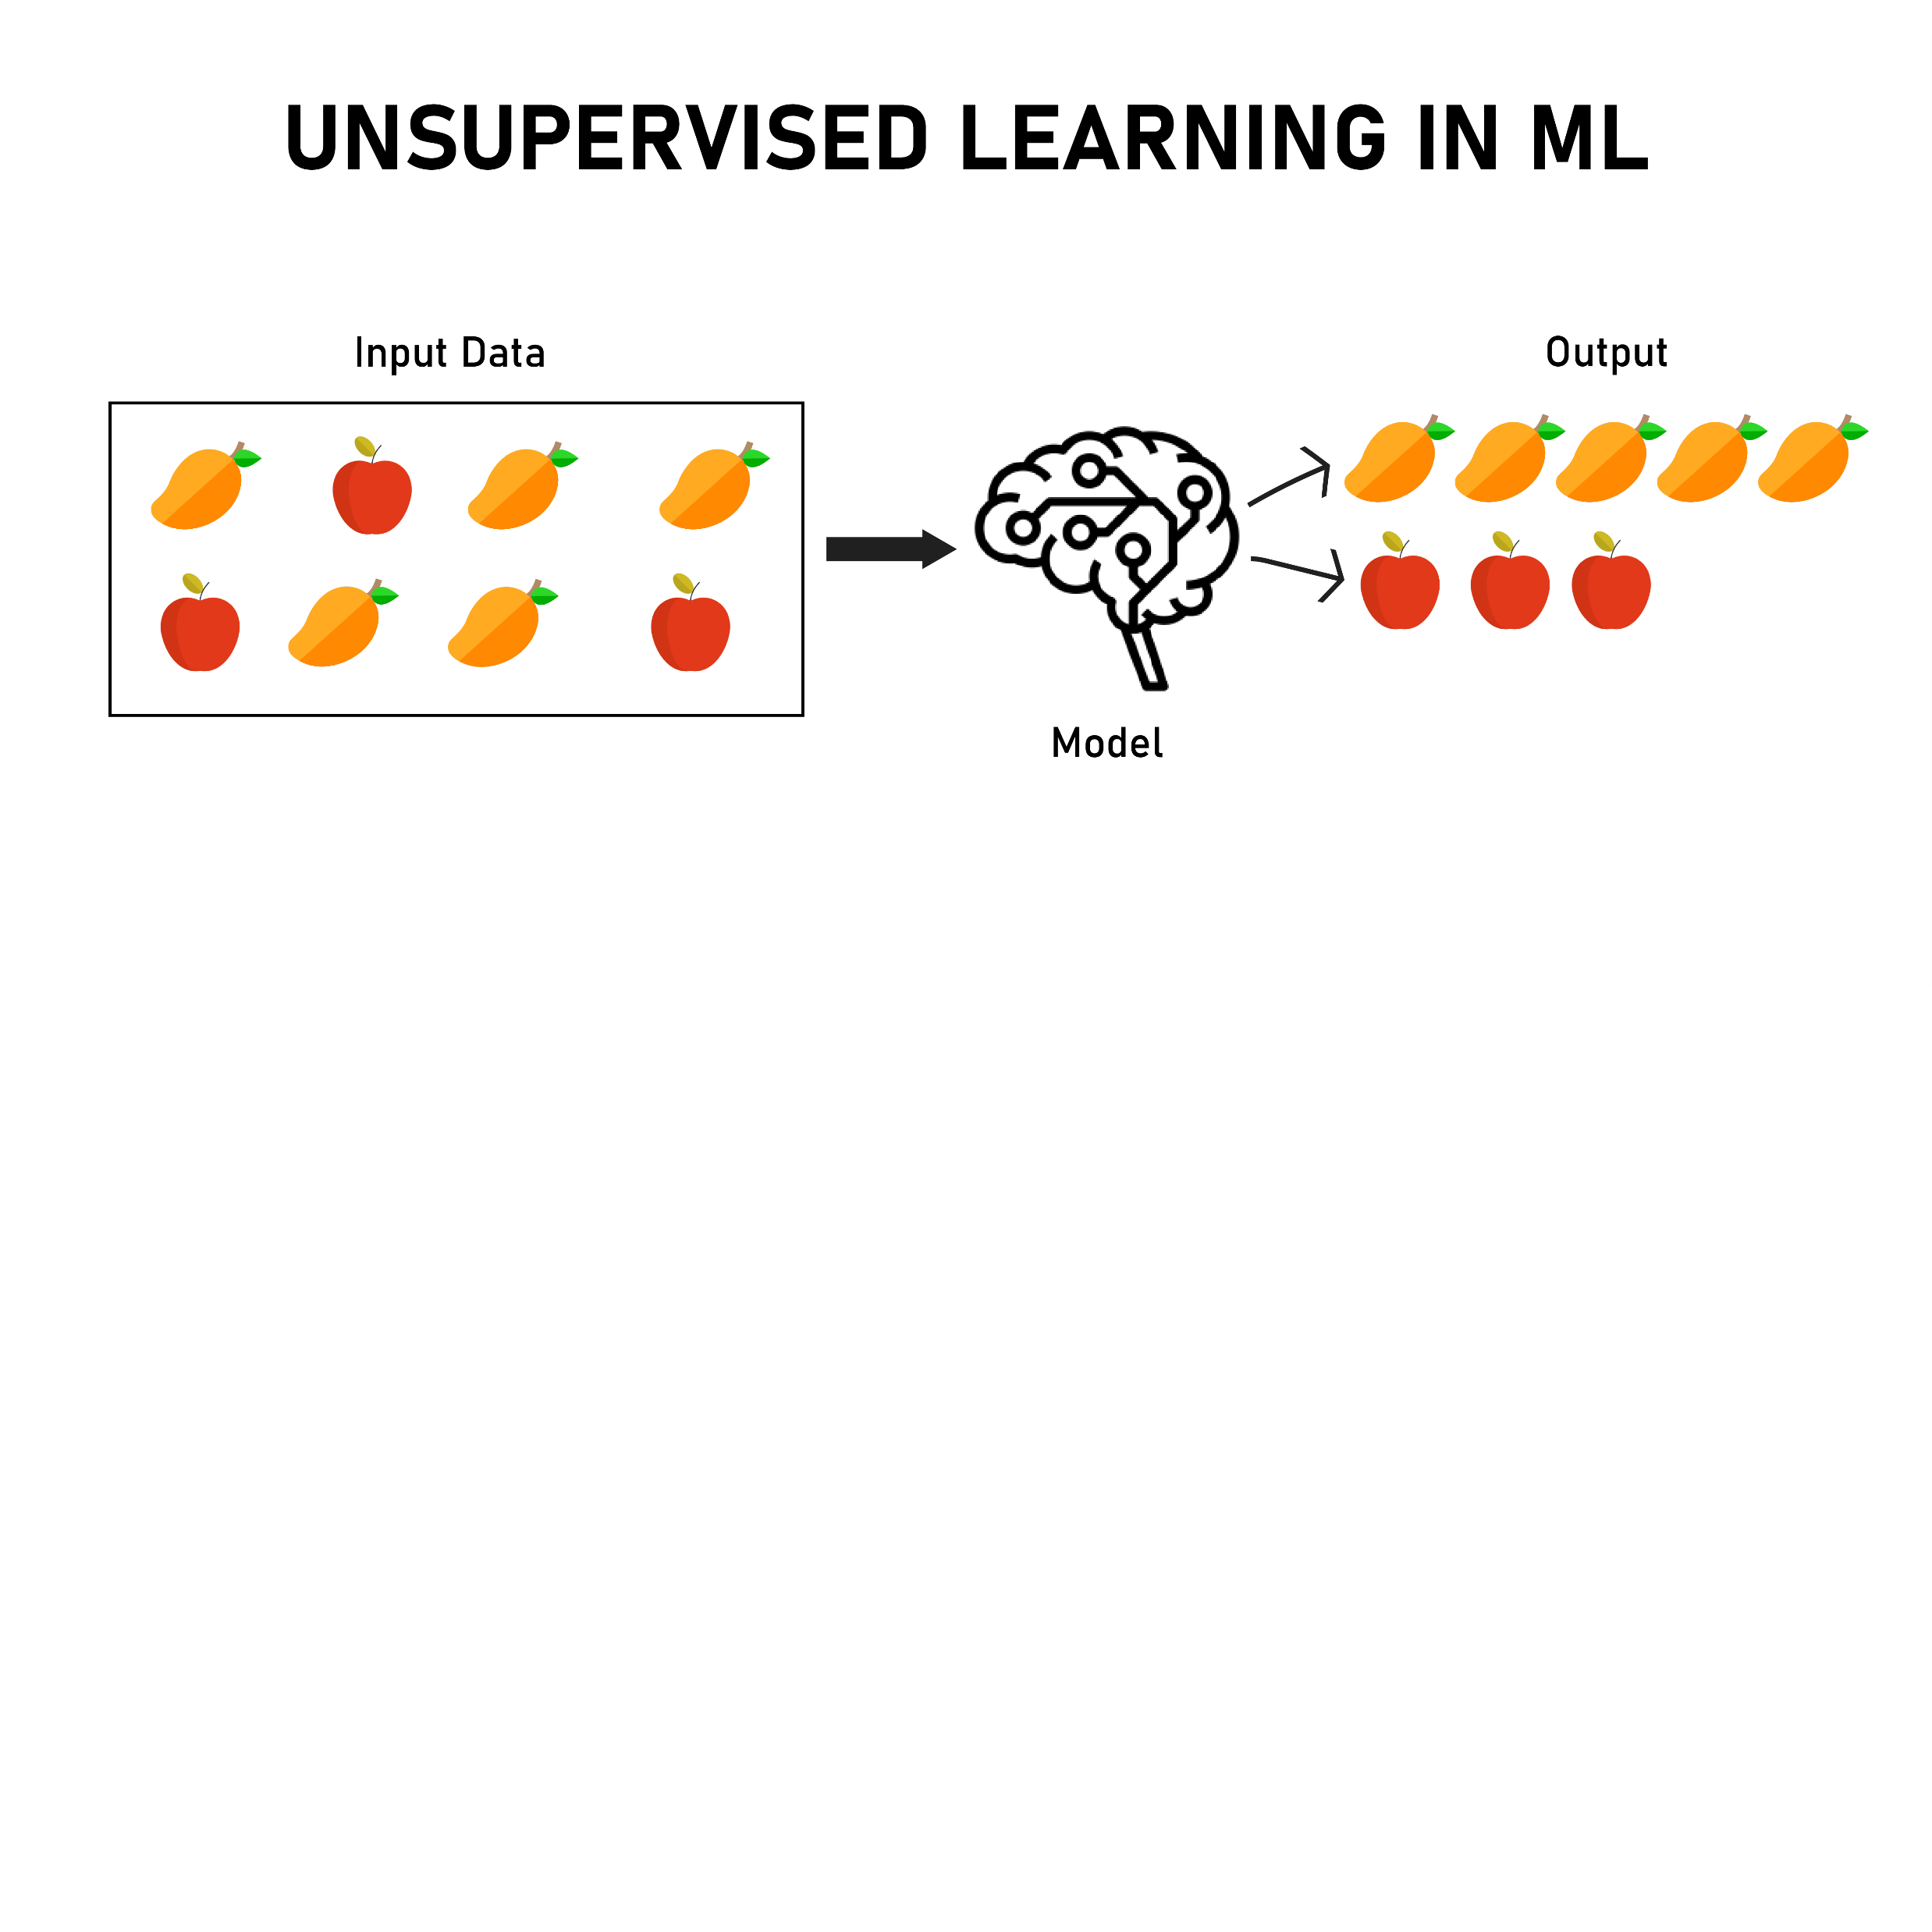
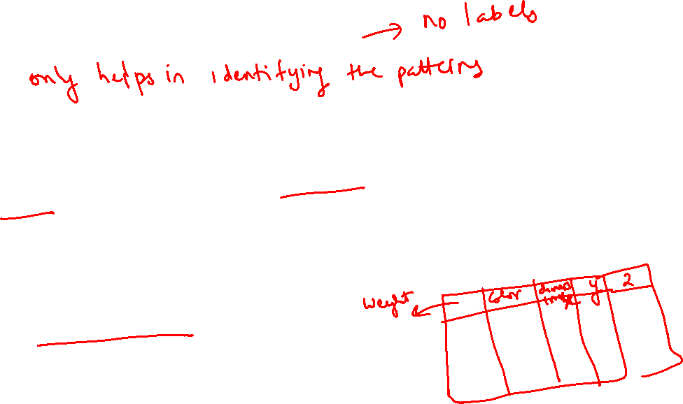
Un-supervised Learning
Un-supervised learning is the type of ML algorithms in which ML model identifies patterns in the data
It automatically identifies group of similar examples
E.g., Clustering models
Group customers with similar location, salary etc.
Group similar customer complaints

Slide 11
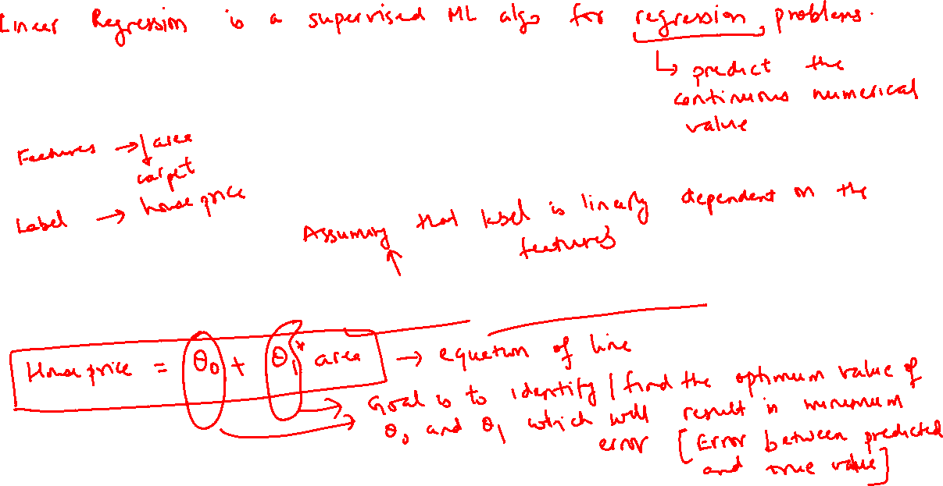
What is Linear Regression?

Slide 12
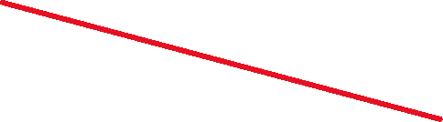
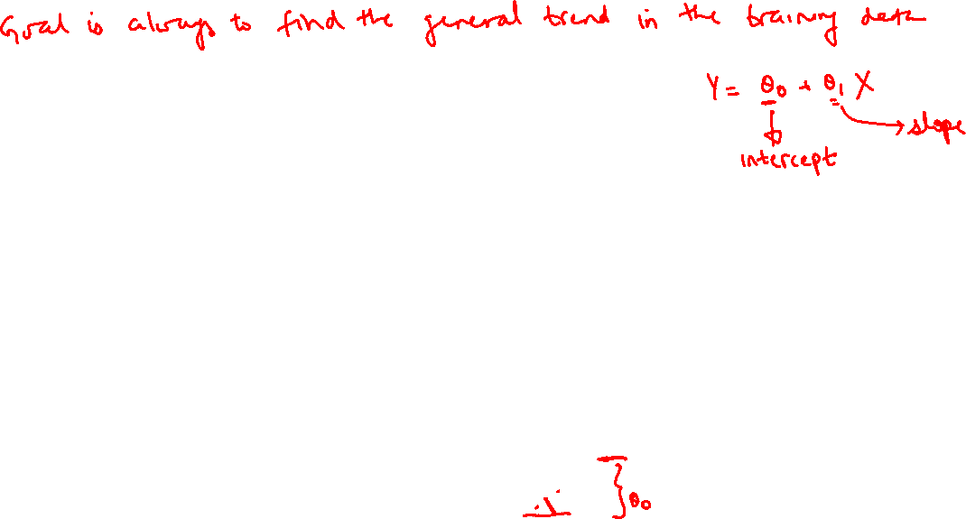


What is linear regression?
X axis represents carpet area of house in sq.ft. and Y axis represents price
Points on the diagram represent few examples of carpet areas and price of house ( labelled data) from the same locality
Which of the line is better representing relationship between carpet area and house price?
$100k
Y-House Price
$50k
$10k
100
500
1000
X - Carpet area in sq.ft.

Slide 13
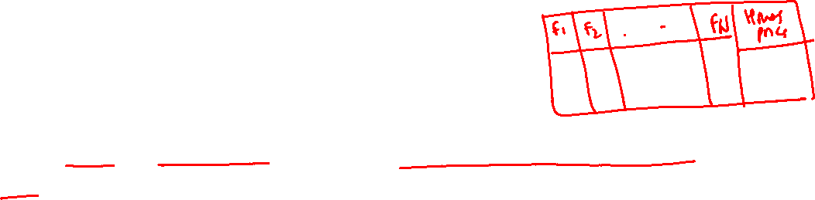
What is linear regression?
It is supervised learning algorithm – Labelled data points are needed to train a model
Linear – It can learn linear relationship between input variable (features) and output variable
Regression – It predicts continuous numerical values as output
Example: Predict price of house based on carpet area in sqft

Slide 14
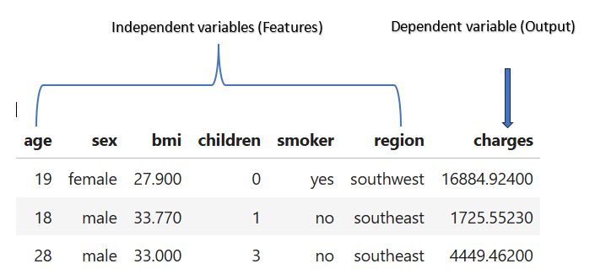

What is linear regression?

Slide 15
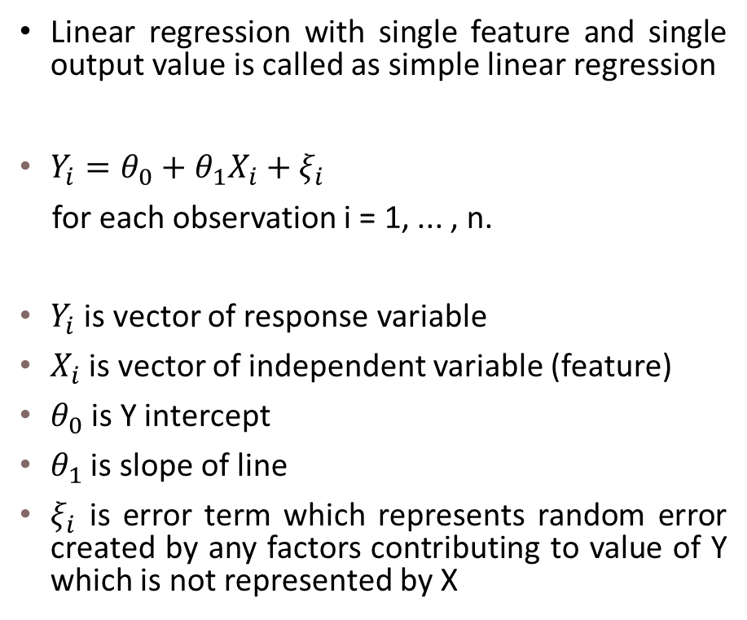


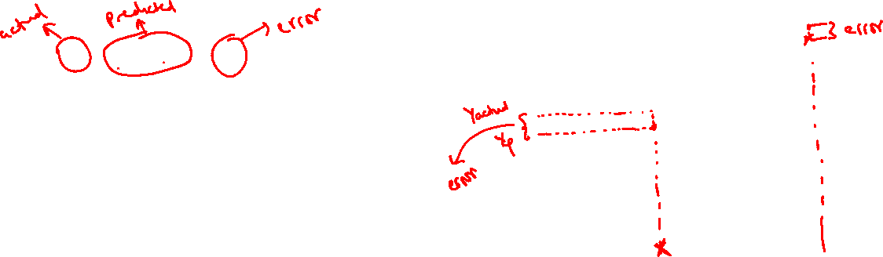
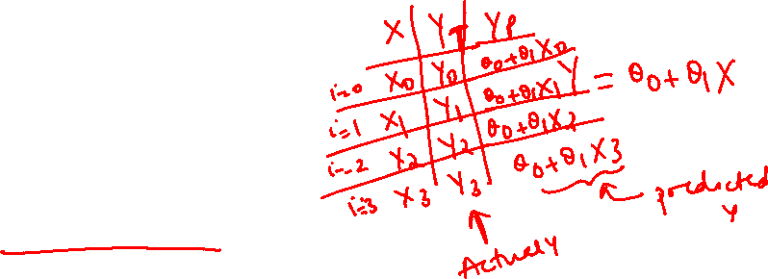
What is linear regression?
Linear regression with single feature and single output value is called as simple linear regression
$Y_{i}=θ_{0}+θ_{1}X_{i}{+ ξ}_{i}$
for each observation i = 1, ... , n.
$Y_{i}$ is vector of response variable
$X_{i}$ is vector of independent variable (feature)
$θ_{0}$ is Y intercept
$θ_{1}$ is slope of line
$ξ_{i}$ is error term which represents random error created by any factors contributing to value of Y which is not represented by X
Y
$$θ_{0}$$
X

Slide 16

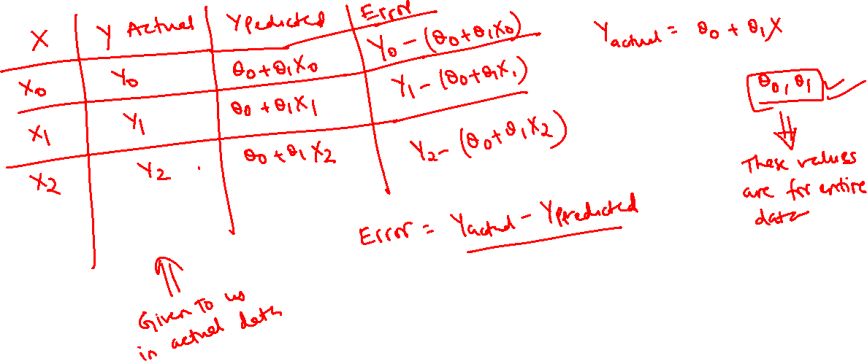

Slide 17
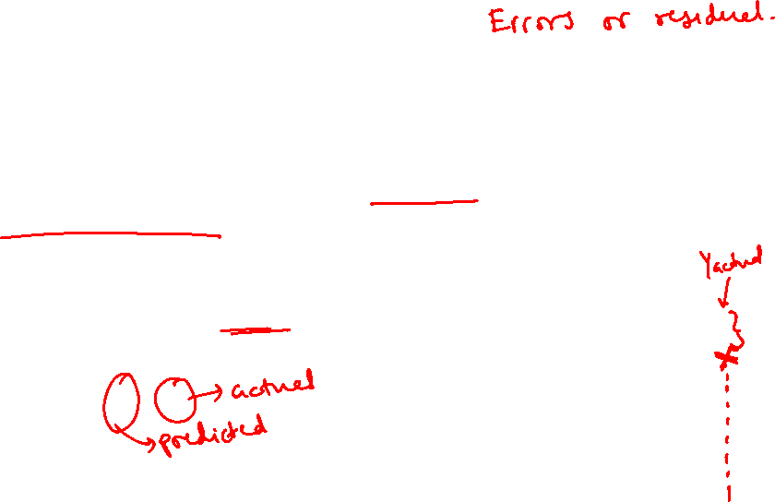
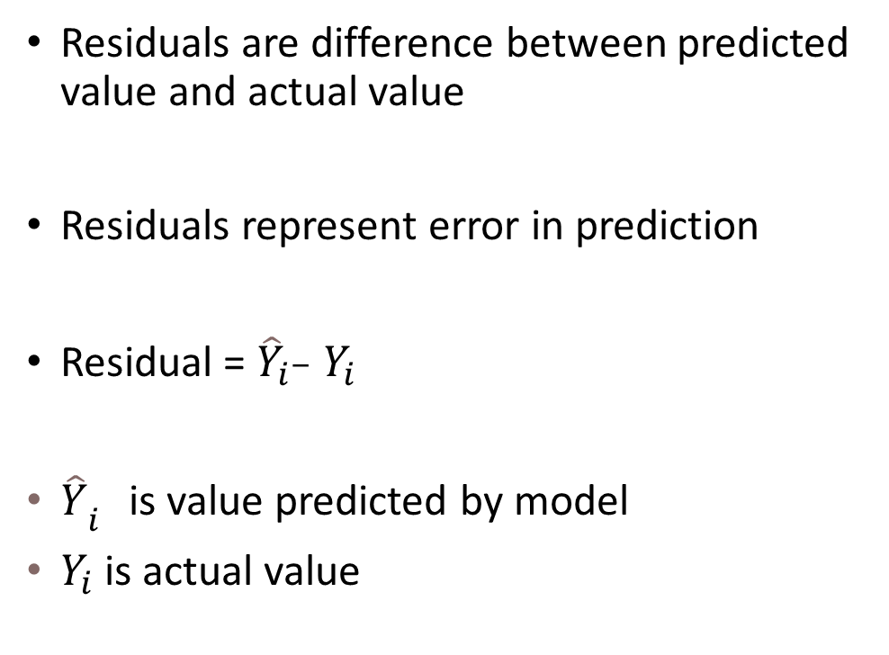

Residuals
Residuals are difference between predicted value and actual value
Residuals represent error in prediction
Residual = ${\hat{Y}}_{i^{−}}$ $Y_{i}$
${\hat{Y}}_{i^{}}$is value predicted by model
$Y_{i}$ is actual value
Y
$$θ_{0}$$
X

Slide 18
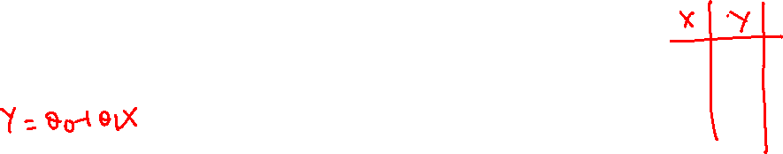

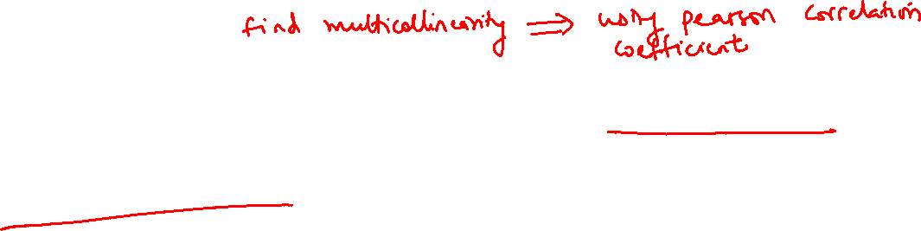
Assumptions of linear regression
Linearity
There should be linear relationship between independent variables (features) and dependant variables
No Multicollinearity
Independent variables should not be correlated with each other
When the independent variables are correlated, it is difficult to isolate the impact of a single factor on the dependent variable which can lead to unexpected results
Independence of residuals
Residuals should not exhibit a systematic pattern or correlation (E.g. residuals increase with time )
If there is a pattern in the residuals, it suggests that there may be some information left in the data that your model has not captured.

Slide 19
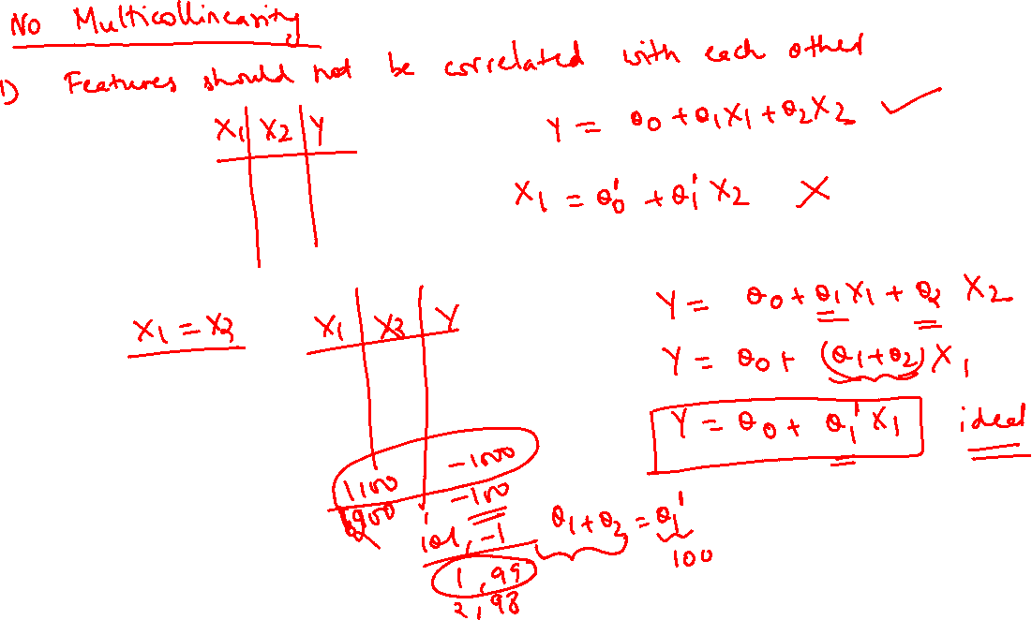

Slide 20
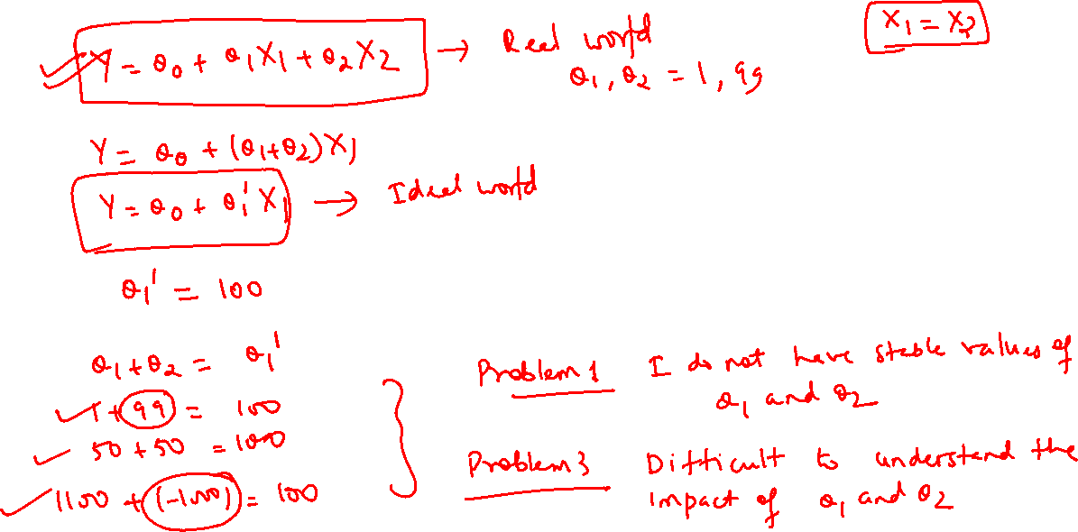

Slide 21
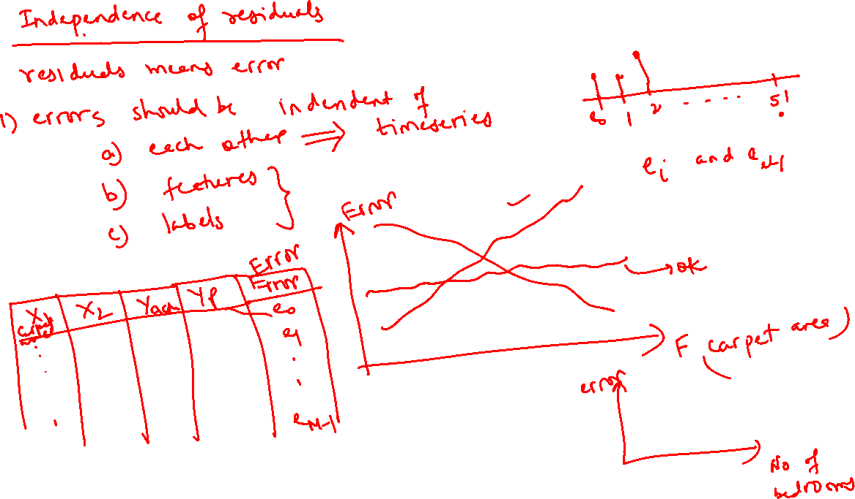

Slide 22
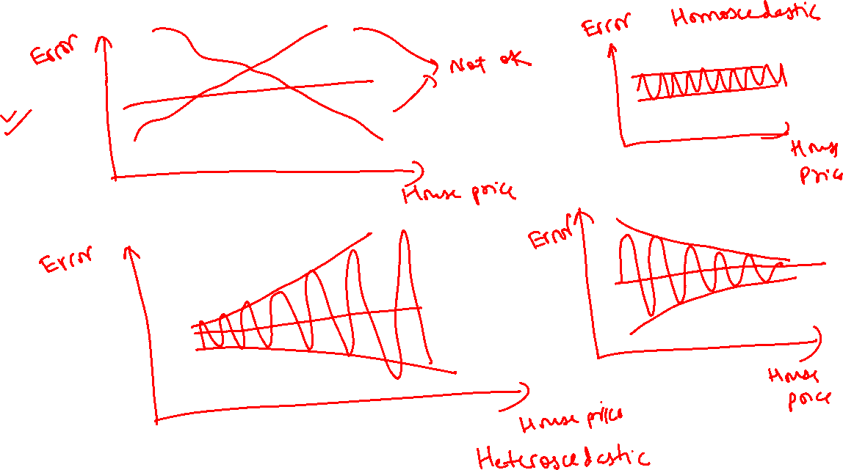

Slide 23
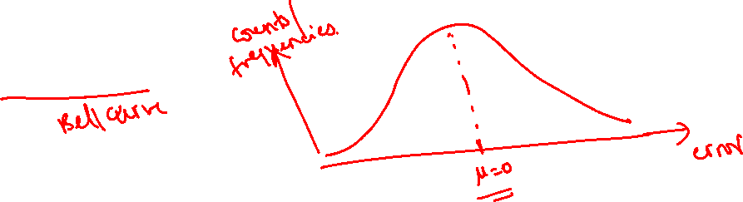
Assumptions of linear regression
Constant variance (homoscedasticity )
Homoscedasticity in a model means that the error has constant variance along the values of the dependent variable.
Normality
Residuals are normally distributed

Slide 24
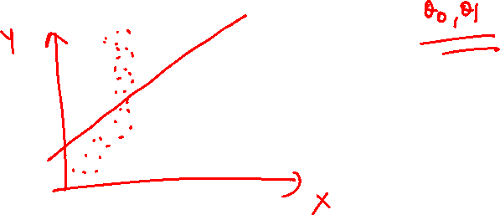
Cost Function and Gradient Descent

Slide 25

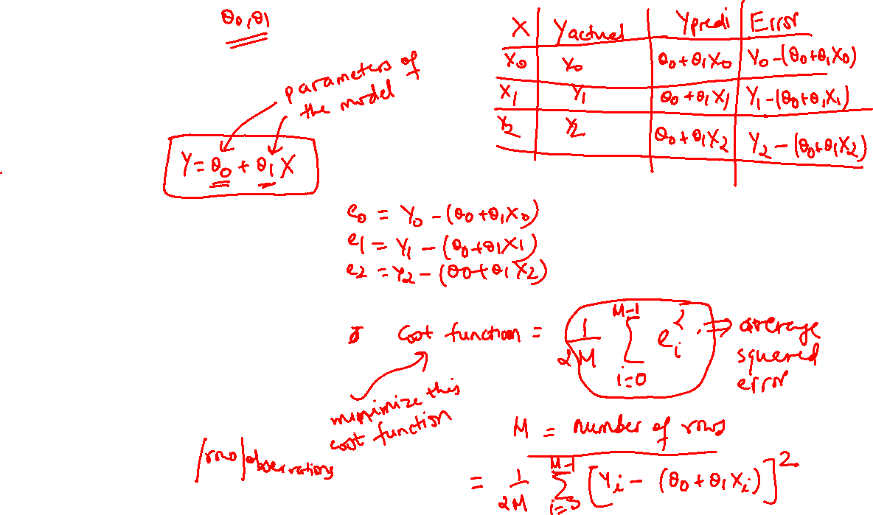
Cost Function
$$Y_{i}=θ_{0}+θ_{1}X_{i}$$
How to estimate value of $θ_{0} and θ_{1}$ ?
We should choose those values of $θ_{0} and θ_{1} which$minimize error between predicted value of model and actual value
Cost Function:
J($θ$) = $\frac{1}{2M}\sum_{i=1}^{M}{}{\left(θ_{0}+θ_{1}X_{i}−Y_{i}\right)}^{2}$
Where M is number of samples

Slide 26
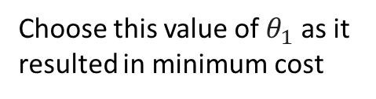
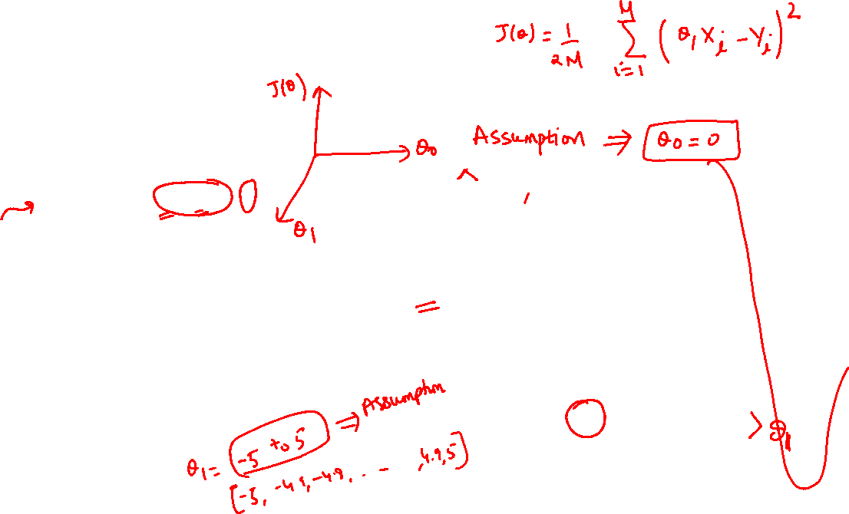
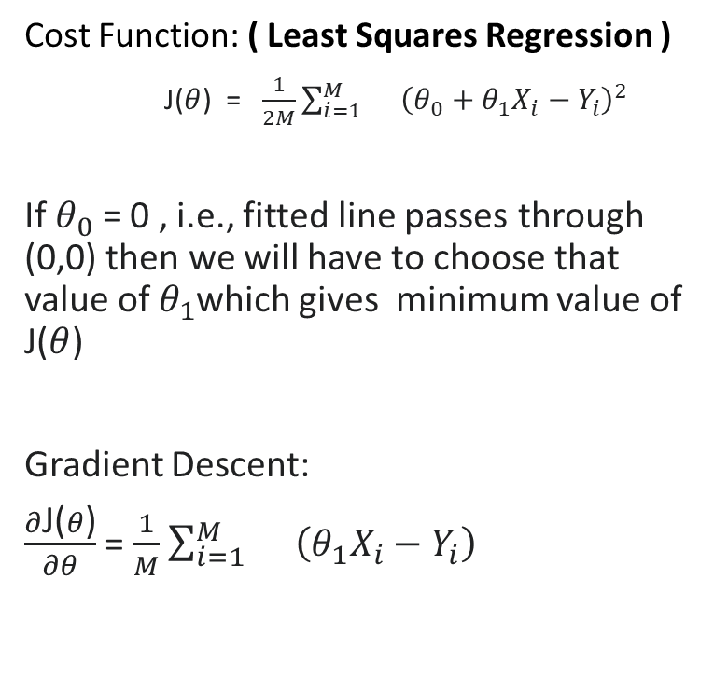


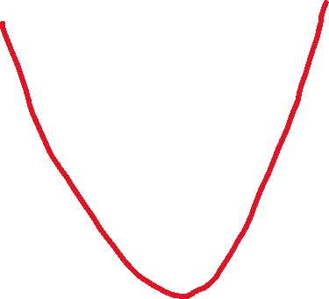

Find optimum parameters
Cost Function: ( Least Squares Regression )
J($θ$) = $\frac{1}{2M}\sum_{i=1}^{M}{}{\left(θ_{0}+θ_{1}X_{i}−Y_{i}\right)}^{2}$
If $θ_{0}$ = 0 , i.e., fitted line passes through (0,0) then we will have to choose that value of $θ_{1}$which gives minimum value of J($θ$)
Gradient Descent:
$\frac{∂\text{J}\text{(}θ\text{)}}{∂θ}$ = $\frac{1}{M}$ $\sum_{i=1}^{M}{}$ ${\left(θ_{1}X_{i}−Y_{i}\right)}^{}$
J($θ$)
$$θ_{1}$$
Choose this value of $θ_{1}$ as it resulted in minimum cost

Slide 27
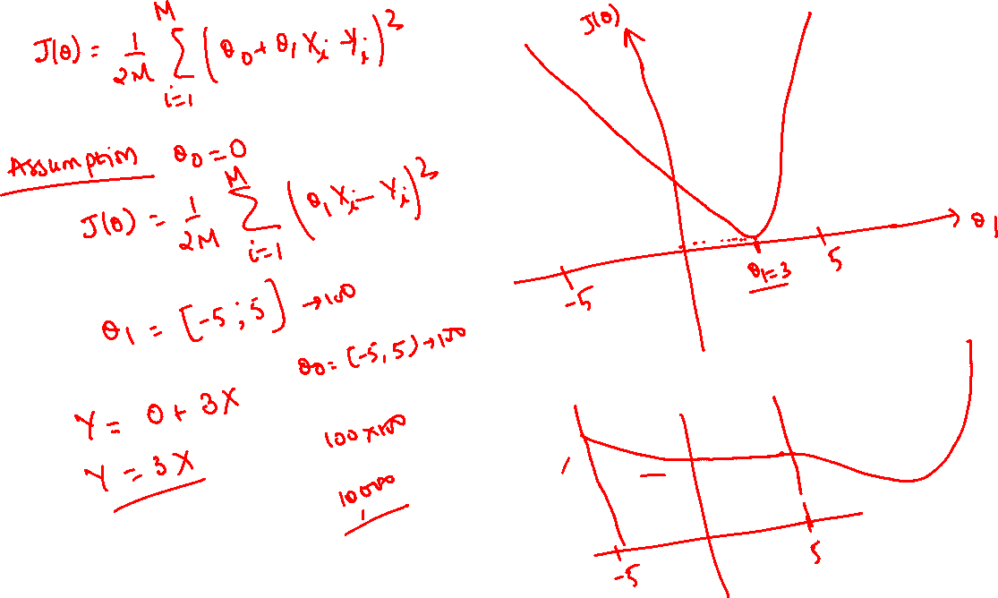

Slide 28
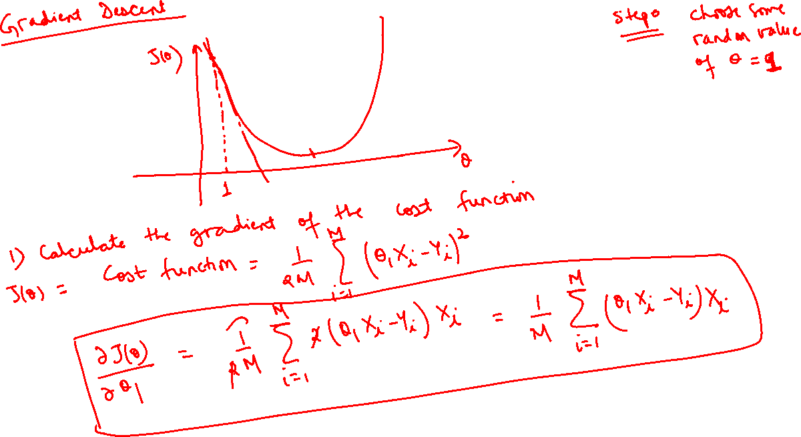

Slide 29
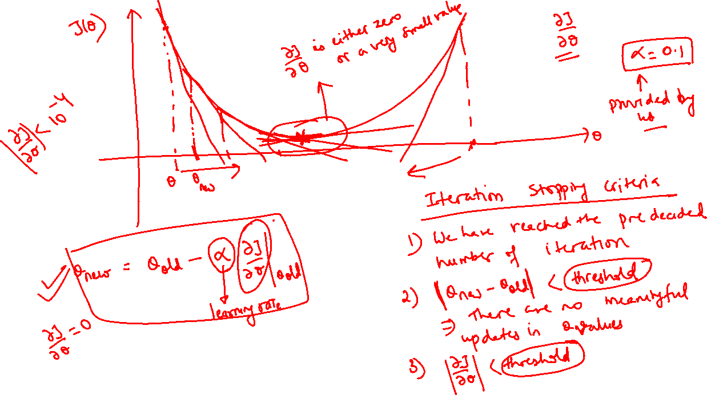

Slide 30
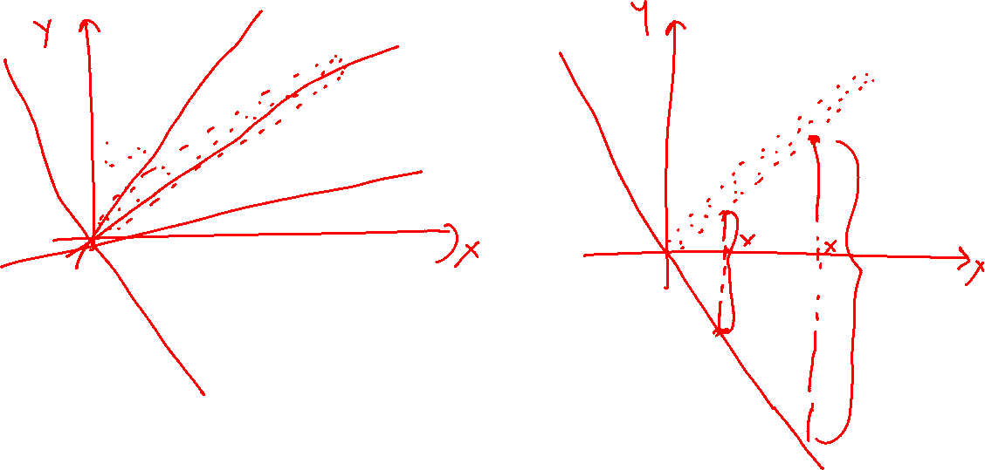

Slide 31







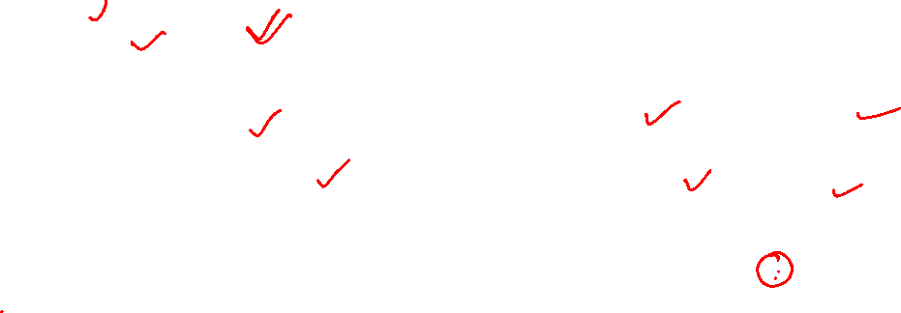

Find optimum parameters
Few examples of fitted lines while finding best parameters
Regression line with minimum cost
Y
J($θ$)
X
$$θ_{1}$$
Choose this value of $θ_{1}$ as it resulted in minimum cost

Slide 32
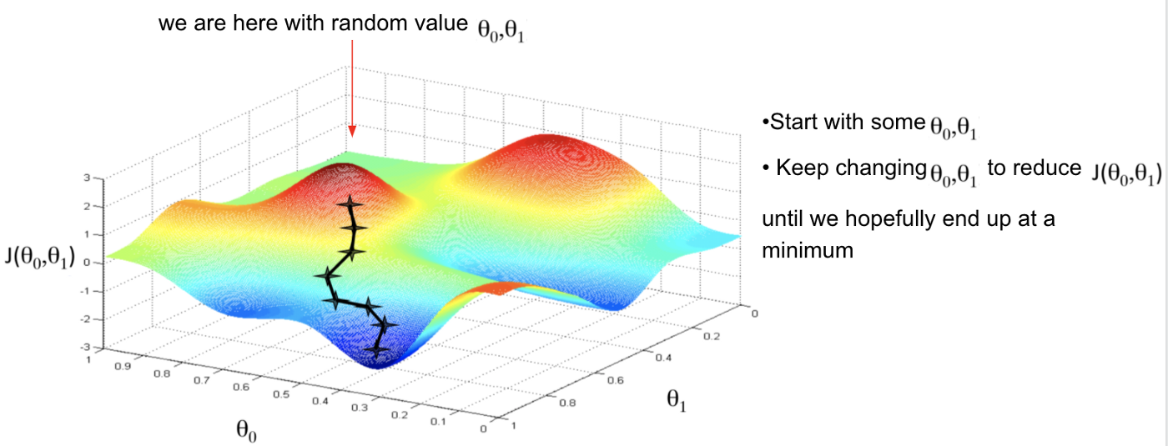

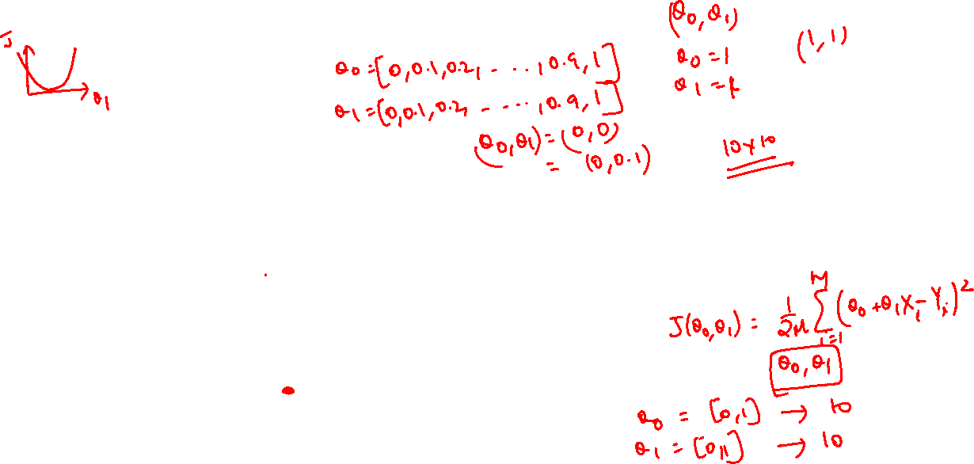
Gradient Descent algorithm

Slide 33
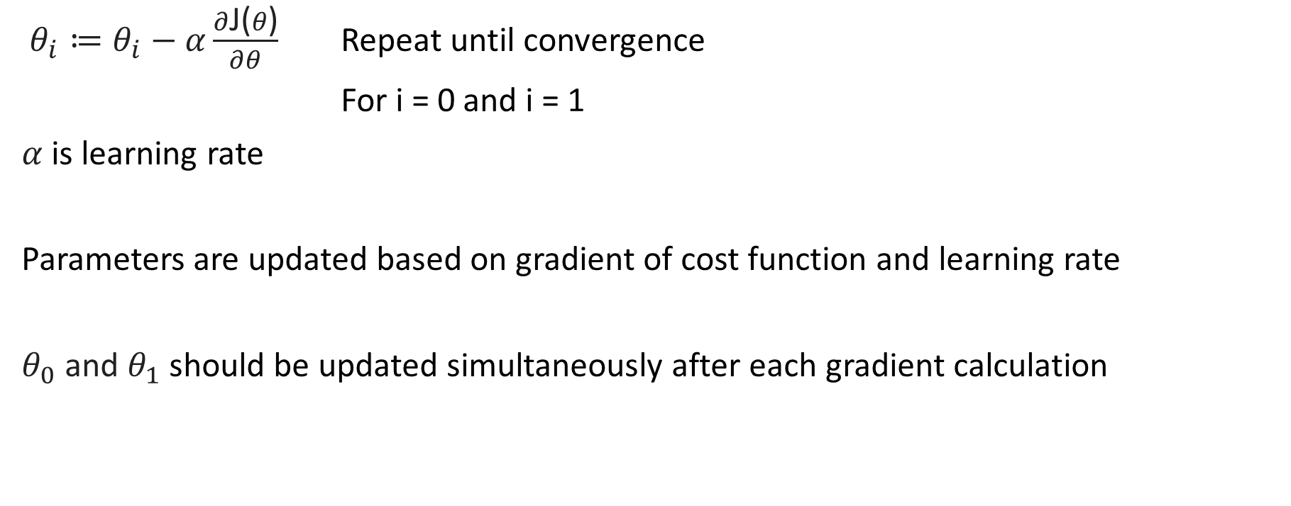
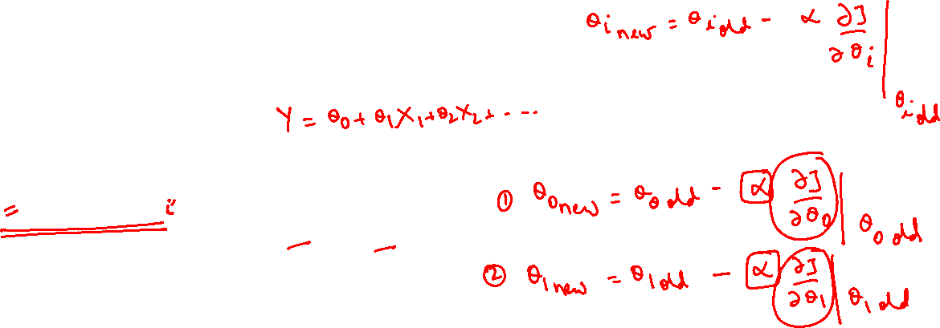
Gradient Descent algorithm
$θ_{i}≔θ_{i}−α\frac{∂\text{J}\text{(}θ\text{)}}{∂θ}$ Repeat until convergence
For i = 0 and i = 1
$α$ is learning rate
Parameters are updated based on gradient of cost function and learning rate
$θ_{0}$ and $θ_{1}$should be updated simultaneously after each gradient calculation

Slide 34
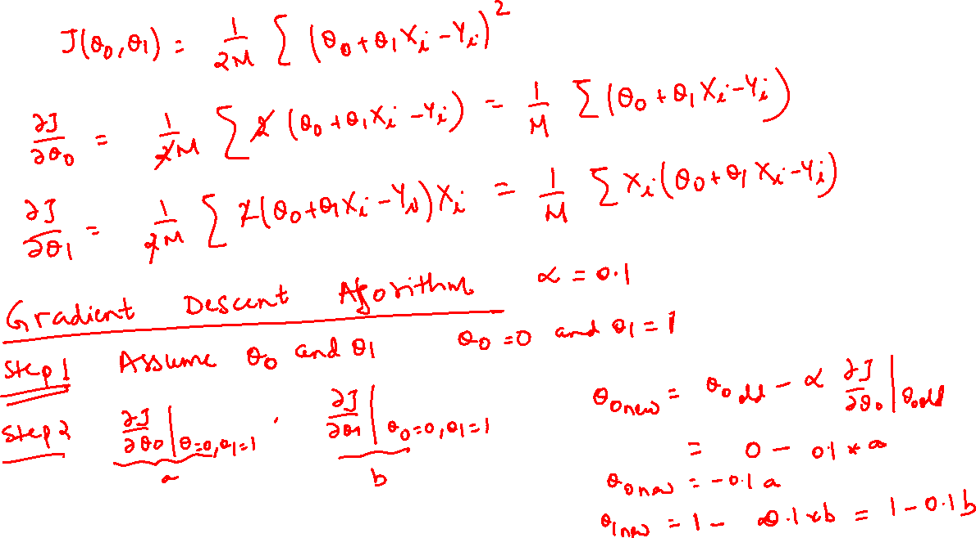

Slide 35
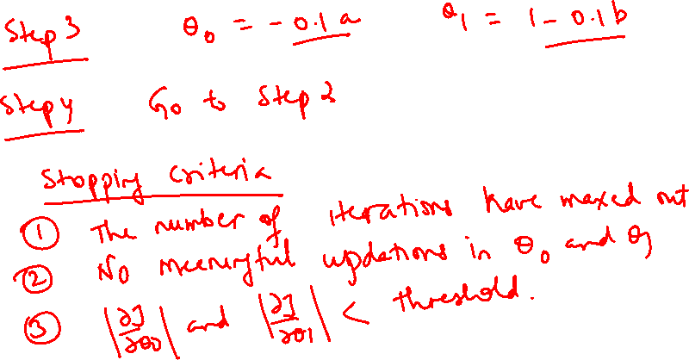

Slide 36
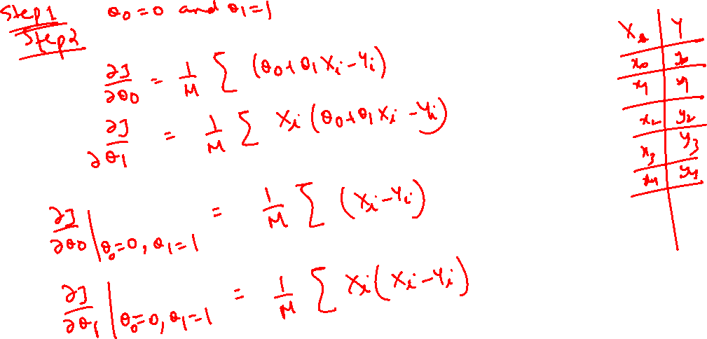

Slide 37


Slide 38


Slide 39


Slide 40






Gradient Descent algorithm
Too small learning rate ($α$) – gradient descent is slow to optimize
Too large learning rate ($α$) – gradient descent may fail to converge due to large updates in parameter value for every gradient
J($θ_{1}$)
$$θ_{1}$$
J($θ_{1}$)
$$θ_{1}$$

Slide 41


Slide 42
Multiple Linear Regression

Slide 43

Types of Linear Regression
Simple Linear Regression
It consists of single independent variable (feature) and single dependant (output) variable e.g., house price prediction based on carpet area of house
Multiple Linear Regression
It consists of multiple independent variables (features) and single dependant (output) variable e.g., house price prediction based on carpet area of house, city, locality, distance to best schools etc.
Multivariate Linear Regression
It consists of multiple independent variables (features) and multiple dependant (output) variables e.g., temperature and humidity prediction based on city, season, month, rainfall

Slide 44



Multiple linear regression?
Linear regression with multiple features and single output value is called as multiple linear regression
$Y_{i}=θ_{0}+θ_{1}X_{i1}+θ_{2}X_{i2} {+…+ ξ}_{i}$
for each observation i = 1, ... , n.
$Y_{i}$ is vector of response variable
$X_{i1}$is vector of independent variable (feature)
$X_{i2}$ is vector of second independent variable (feature)
$θ_{0}$ is Y intercept
$θ_{1}$ is coefficient for variable X1
$θ_{2}$ is coefficient for variable X2
$ξ_{i}$ is error term which represents random error created by any factors contributing to value of Y which is not represented by X

Slide 45


How to find parameters?
Gradient Descent Optimization
Ordinary Least Square (applicable to simple linear regression as well )

Slide 46


Slide 47


Slide 48



Ordinary Least Square
It is a common (ordinary) method used for finding the best-fitting line through a set of data points by minimizing the sum of the squared differences between the observed and predicted values.
Note: As this method involves matrix operations such as inverse computation its computationally and memory expensive method for high dimensional data
$$Y_{}=θ_{0}+θ_{1}X_{1}+θ_{2}X_{2}$$
Y = X$θ$ ( Matrix notation )
$$θ={\left(X^{T}X\right)}^{−1}X^{T}Y$$

Slide 49

Evaluation of Regression Models

Slide 50





Evaluation metrics for Regression
Mean Absolute Error (MAE)
It is average of absolute error values
MAE = $\frac{1}{M}\sum_{i=1}^{M}{\left|Y_{i}−{\hat{Y}}_{i}\right|}$
Mean Absolute Percentage Error (MAPE)
MAE represented in percentage format
MAPE = $\frac{1}{M}\sum_{i=1}^{M}{\left|{(Y}_{i}−{\hat{Y}}_{i} )\text{/ }Y_{i}\right|}$ * 100
Root Mean Square Error (RMSE)
It is square root of average
squared error values
RMSE = sqrt( $\frac{1}{M}\sum_{i=1}^{M}{{(Y}_{i}−{\hat{Y}}_{i}}) )$
2
$Y_{i}$ is actual value of dependant variable
${\hat{Y}}_{i}$ is predicted value by model

Slide 51



Evaluation metrics for Regression
2
R-Squared Score (R )
It is the proportion of the variation in the dependent variable that is predictable from the independent variables
It is also called as coefficient of determination
Mean of Y:
$\overline{Y}$ = $\frac{1}{M}\sum_{i=1}^{M}{Y_{i}}$
Sum of squares of residuals:
$SS_{res}= \frac{1}{M}\sum_{i=1}^{M}{{(Y}_{i}−{\hat{Y}}_{i})}$
Total sum of squares:
$SS_{tot}=\frac{1}{M}\sum_{i=1}^{M}{{(Y}_{i}−\overline{Y})}$
$$R^{2}=1−\frac{SS_{res}}{SS_{tot}}$$
2
2

Slide 52


Slide 53


Slide 54




Evaluation metrics for Regression
2
R-Squared Score (R )
$R^{2}$ will be 1 for model which predicts values which exactly match actual values
$R^{2}$ will be 0 for model which predicts every value as mean of Y (baseline)
$R^{2}$ will be negative for model which has worst prediction than baseline
Y
$$R^{2}=1$$
X
Y
$$R^{2}=0.8$$
X
$$R^{2}=0$$
X
X

Slide 55

Questions?

